Slide 1
2 CFR 200.308
10% budget revision examples

Slide 2
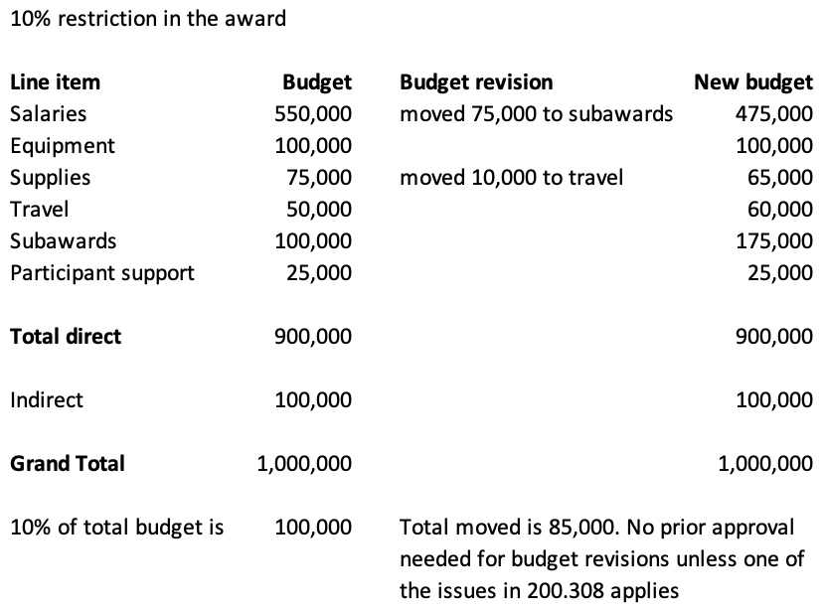
Budget revisions
200.308

Slide 3
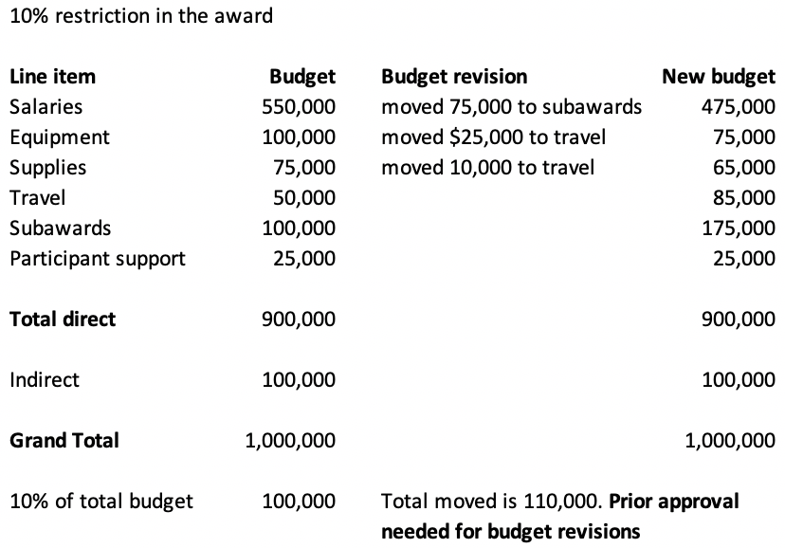
Budget revisions
200.308

Slide 4
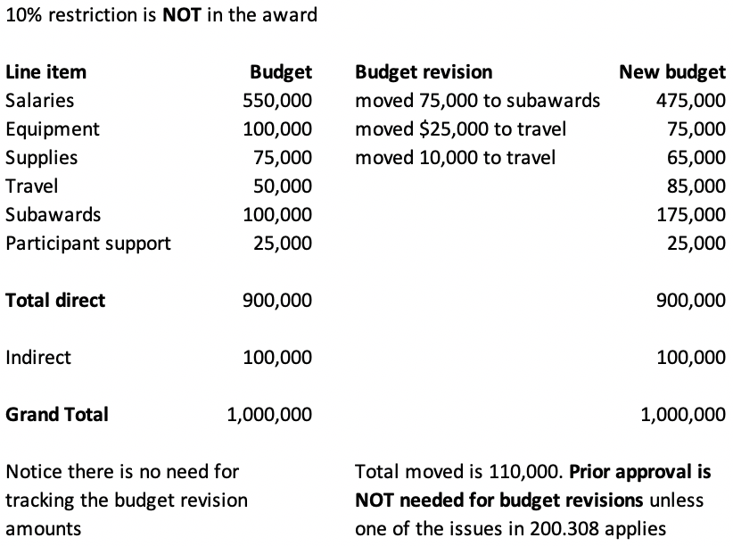
Budget revisions
200.308

Slide 5
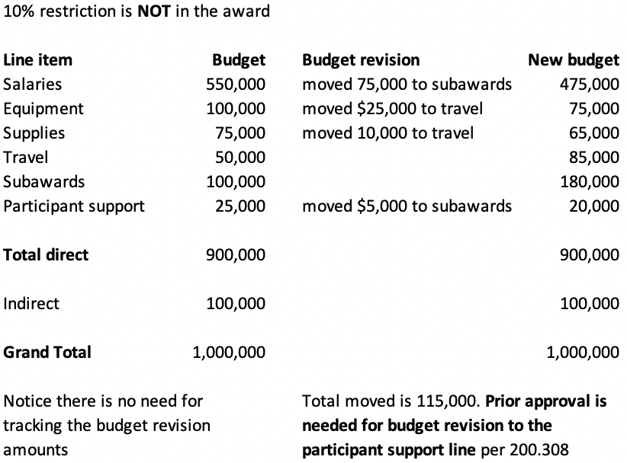
Budget revisions
200.308

